Slide 2

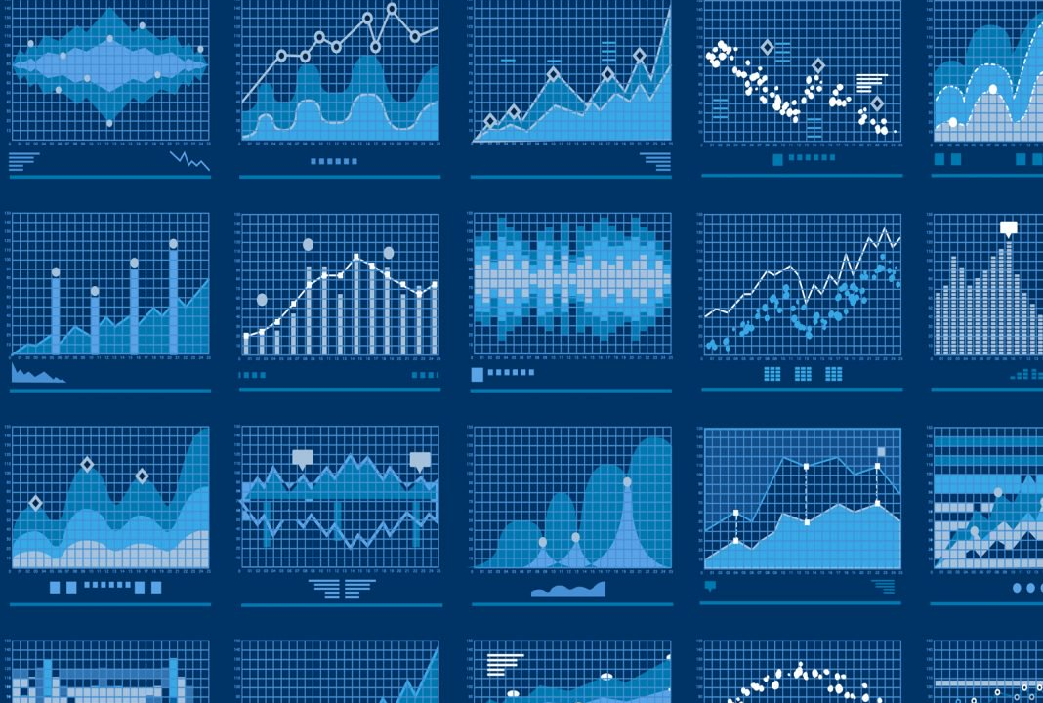
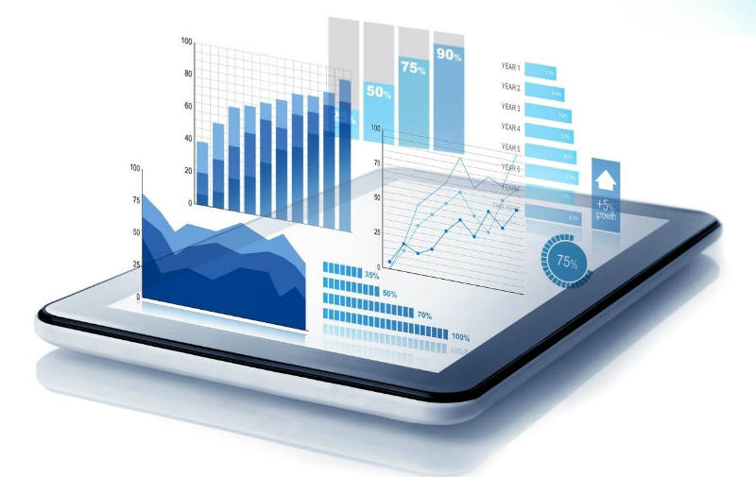
Big Data project: “Algorithmic trading, getting an edge through technology”
Group 21

Slide 3
The plan
Why algorithmic trading?
The concept
Technical analysis
Fundamental analysis
What’s next?
(Demo)
(Demo)

Slide 4
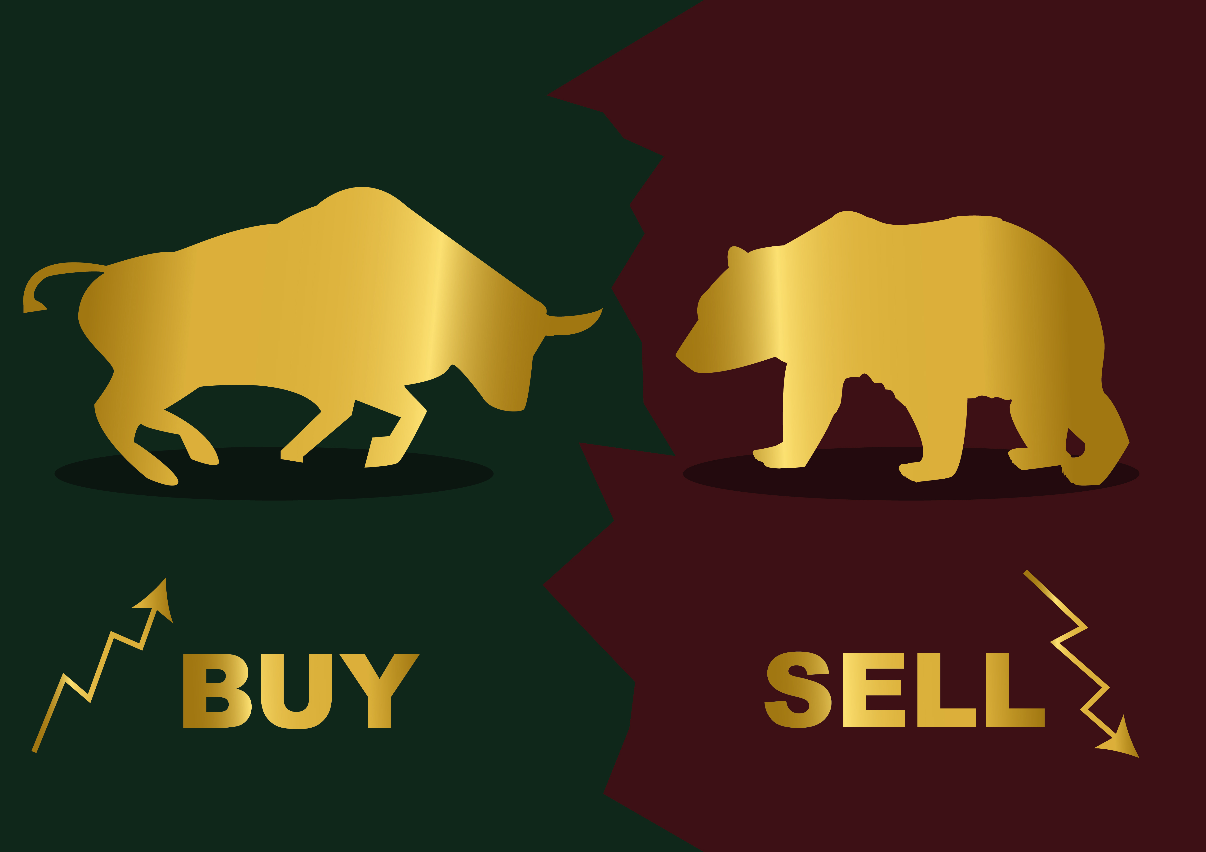
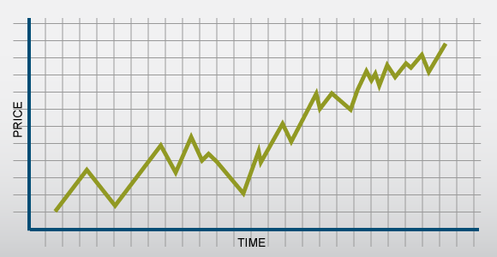
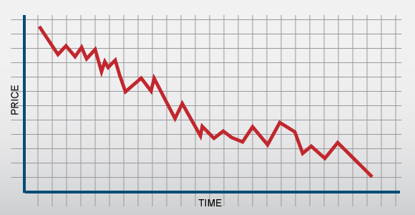
Quick recap on the basics
Analysis type:
Technical analysis
Fundamental analysis
Technical indicators:
RSI (relative strength index)
SMA (simple moving average)
Volatility
Volume
etc…
News/headlines
Economic events
Sentiment analysis:
Twitter
Google trends
etc…

Slide 5

Ticker: AAPL
Net worth: $ 990 Billions
IPO price: $22 per share
Closing price yesterday: $220

Slide 6
Algorithmic trading, the way to go?

Slide 7


Write the rules…
… and let the machines follow

Slide 8
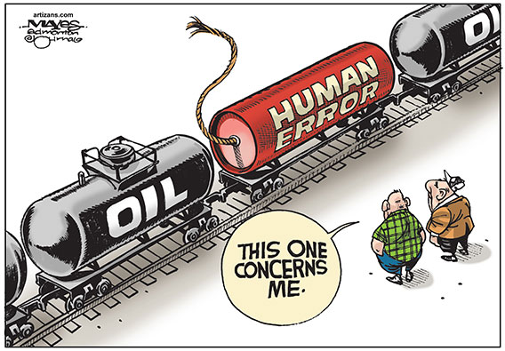



… and achieve perfect consistency in decision making
Avoid human error…

Slide 9
The concept
So how is it done?

Slide 10

Collecting information from various sources
Market opening and closing prices
Twitter data
Daily high - low
Google trends
Market volume
Market news
Dow Jones index
…
…

Slide 11

Combining the knowledge of all data source and indicators
Buy
Buy
Buy
Buy
Buy
Buy
Buy
Buy
Make buy and sell decisions when the information gathered reach a consensus

Slide 12
Technical analysis

Slide 13
Technical indicators
A solid economics modeling tool
- An accurate representation of the economic situation
- The ability to make educated Buy and Sell decisions
RSI
SMA
EMA
Volatility
Volume
etc…
A two-step
analysis process:
Machine learning..?

Slide 14
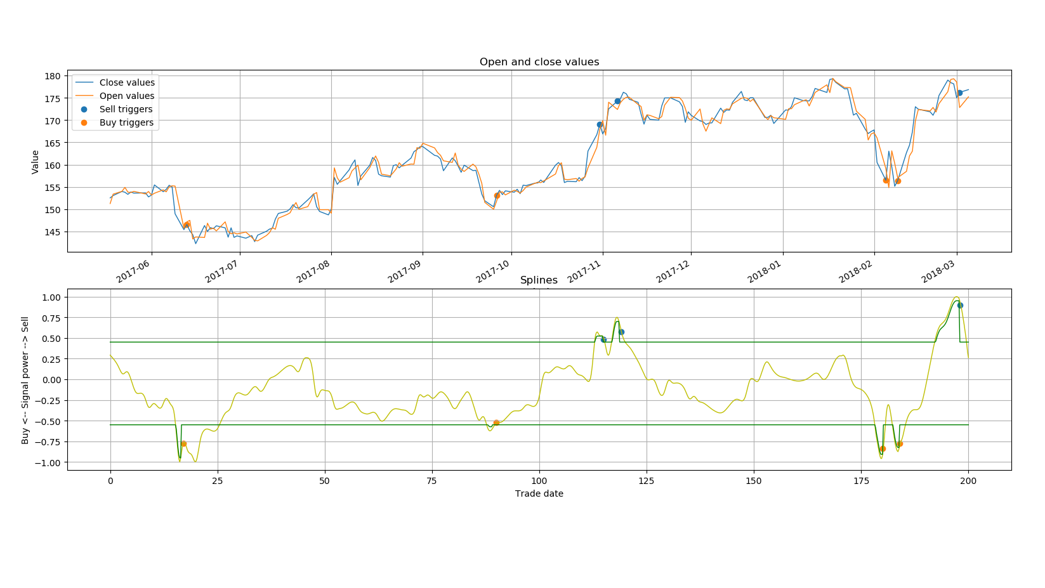

Slide 15
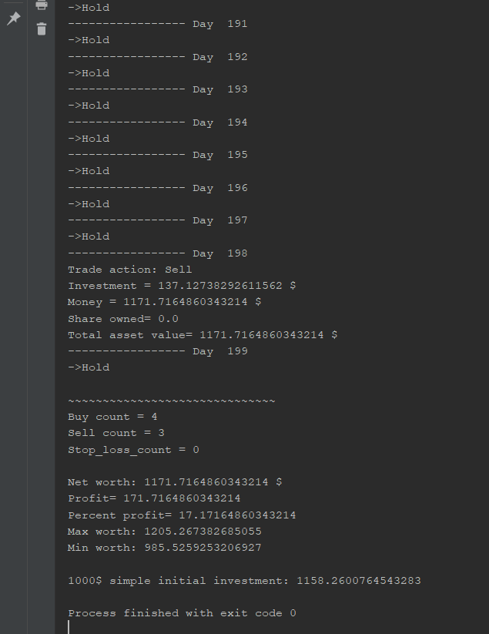
Trade bot
Trading strategy
Market model
Profit… ?

Slide 16
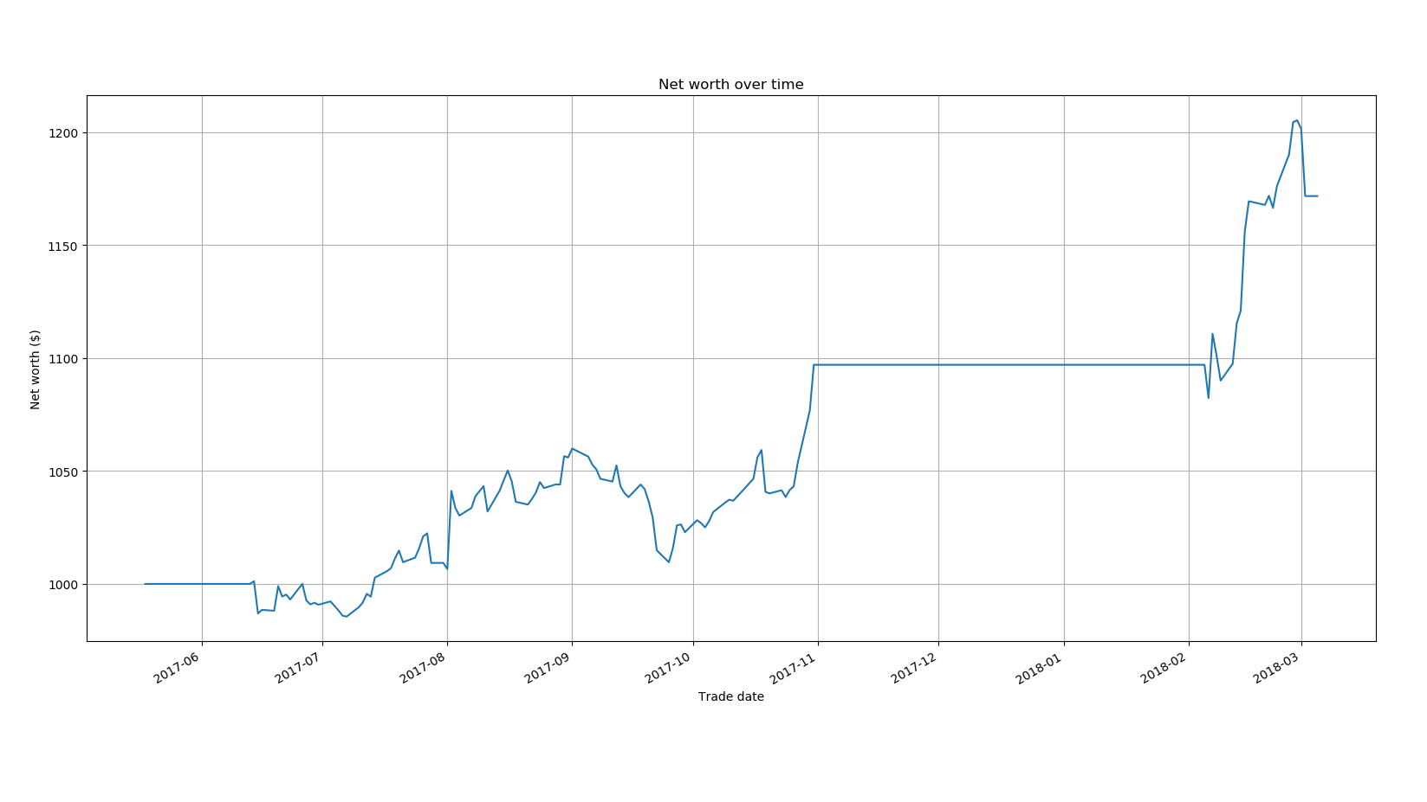

Slide 17
Fundamental analysis

Slide 18
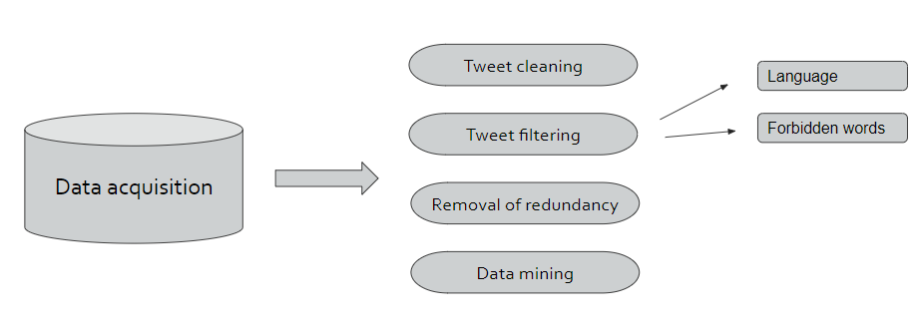
Data collection and processing

Slide 19

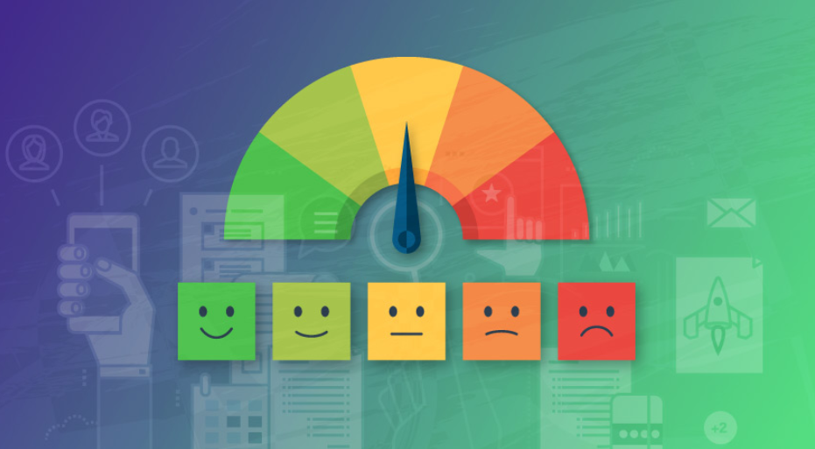

Sentiment analysis
High impact

Slide 20
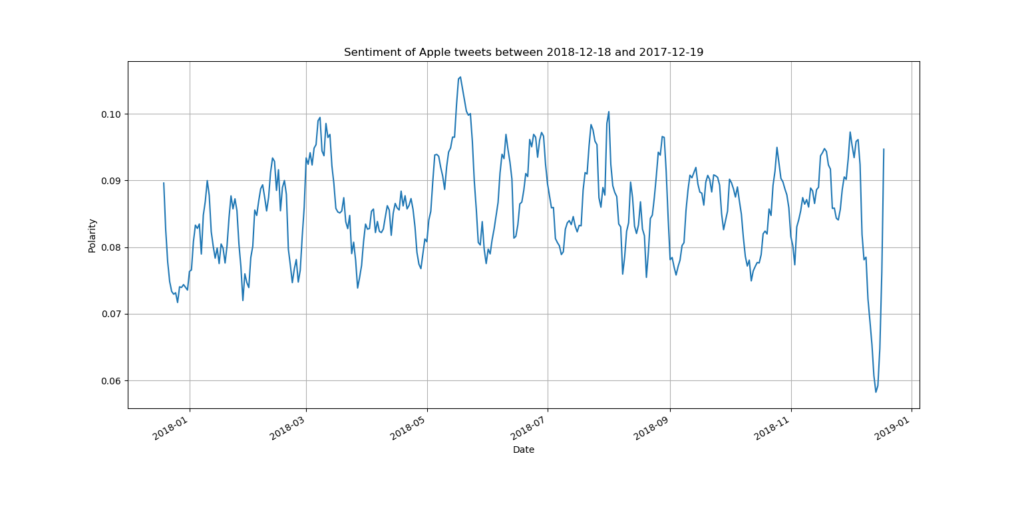

Slide 21
What’s next?

